Slide 1

1

Slide 2
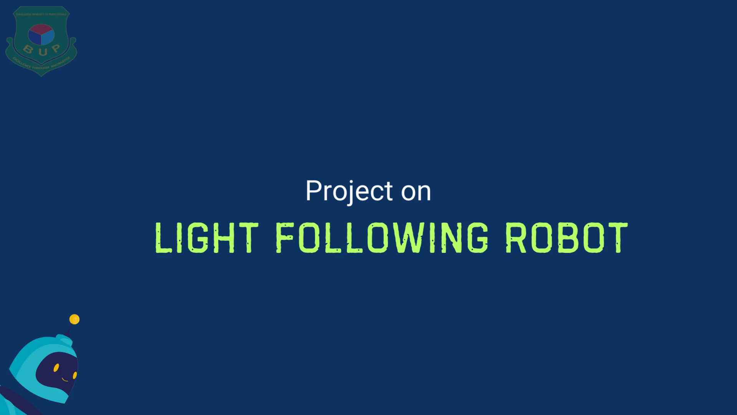
2

Slide 3
Meet the Team
Student Name | Roll Number
Shamoyeta Mourin Mouly | 2252421036
Latifa Nishat Nishi | 2252421062
Jayed Bin Alamgir | 2252421066
Tahsina Tabassum Roza | 2252421084
3

Slide 4






Outline of the Presentation
Introduction
Background
Study
Research
Gap
Objective
Methodology
Conclusion
4

Slide 5
Introduction
5

Slide 6
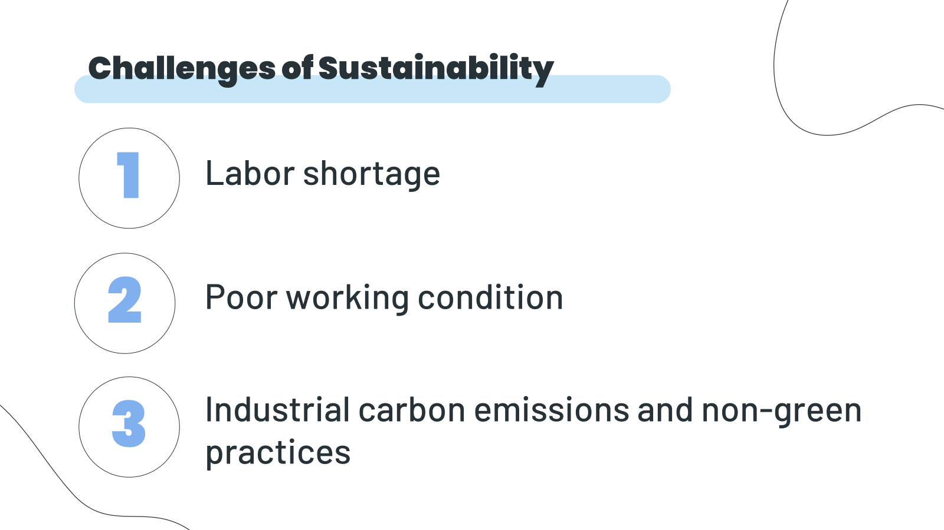
1
2
3
Labor shortage
Poor working condition
Industrial carbon emissions and non-green practices
6

Slide 7
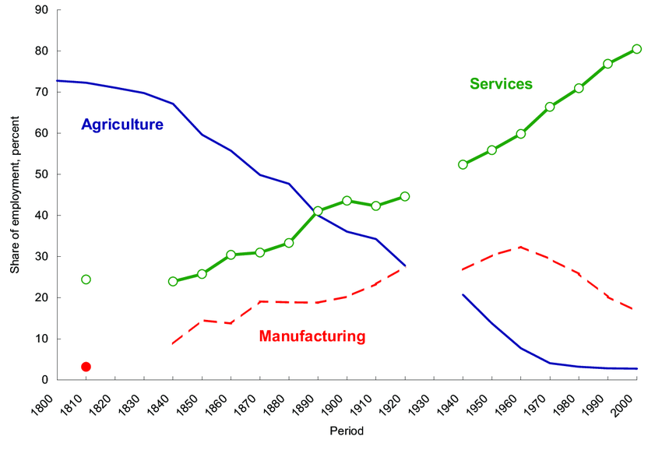
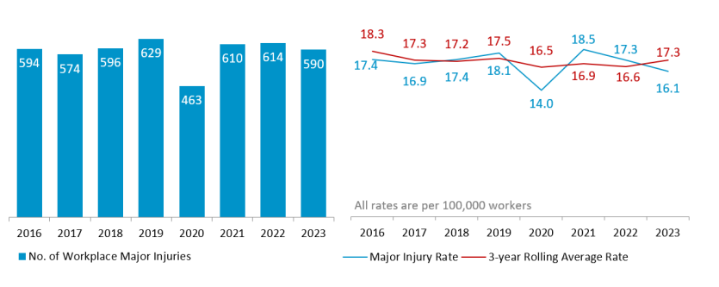
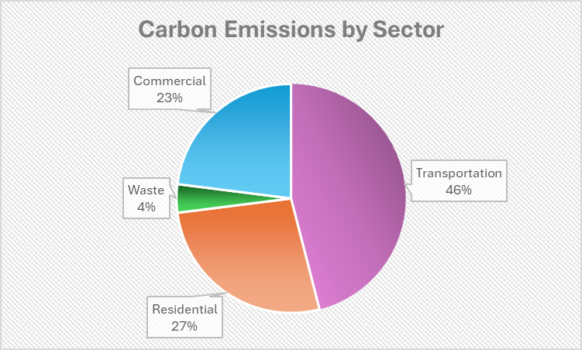
1
Challenges of Sustainability
2
3
Labor shortage
7
Poor working condition
Industrial carbon emissions and non-green practices

Slide 8
1
2
Challenges of Sustainability
3
Labor shortage
Poor working condition
8
Industrial carbon emissions and non-green practices

Slide 9
2
1
Challenges of Sustainability
3
Poor working condition
Labor shortage
Industrial carbon emissions and non-green practices
9

Slide 10
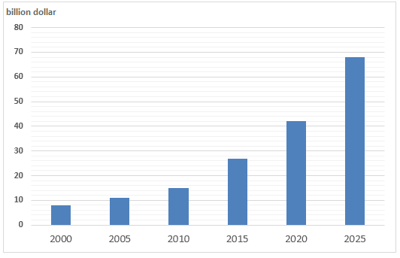
Size of global robotics market 2000-2025 (Estimation)
10

Slide 11

Light Following Robot
11

Slide 12
Benefits of using Light-following robots
Improved Safety
Enhanced Automation
Environmental Sustainability
Cost-Effectiveness
Efficiency and Precision
12

Slide 13
Background Study
13

Slide 14

Background Study cont…
Core concept
Phototaxis( the biological phenomenon where organisms orient their movement in response to light)
14

Slide 15

Background Study cont…
Grey Walter’s
light sensitive robot
15

Slide 16
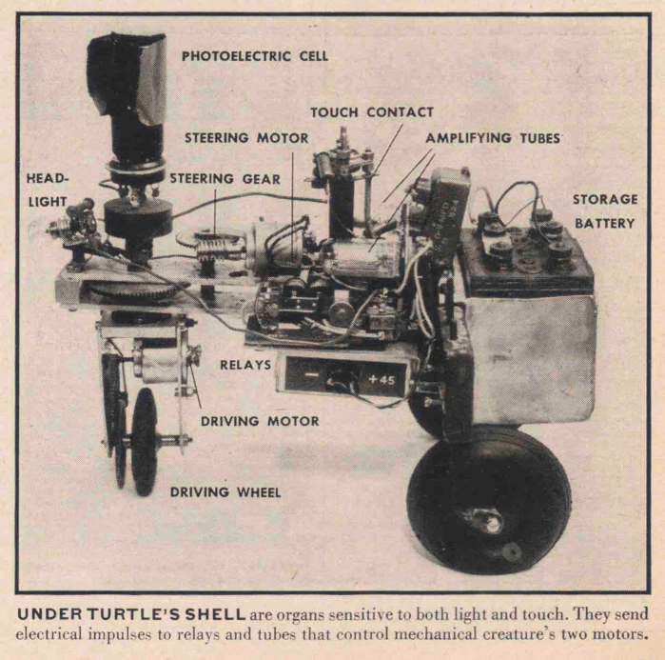
Background Study cont…
Grey Walter’s
light sensitive robot
16

Slide 17
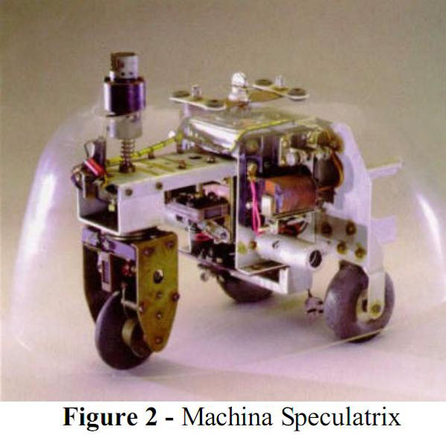
Background Study cont…
Grey Walter’s
light sensitive robot
17

Slide 18
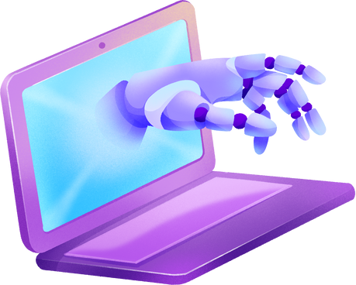

Background Study cont…
Behavior based robotics
18

Slide 19
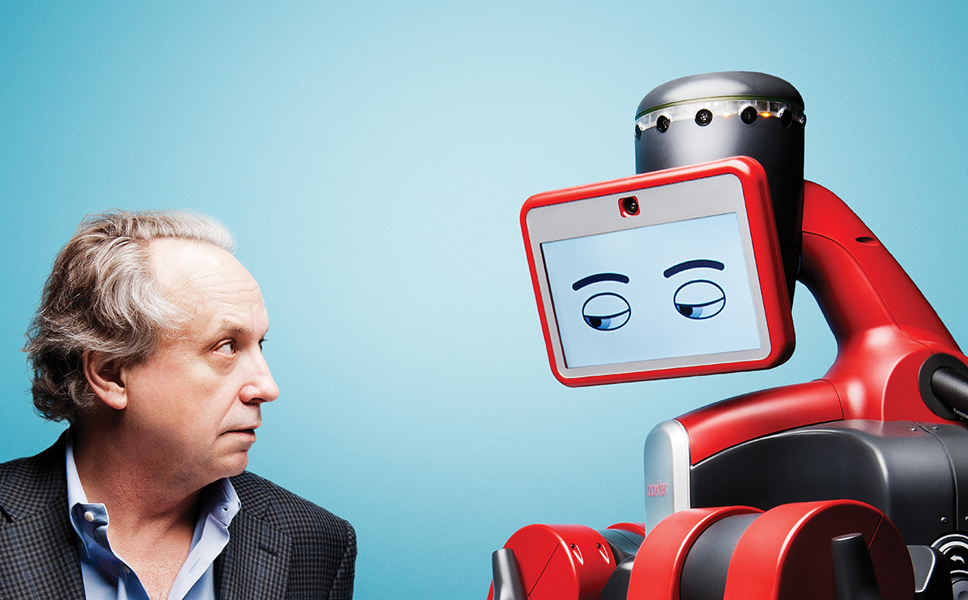
Background Study cont…
Behavior based robotics
By roboticist and artificial intelligence researcher, Rodney Brooks
19

Slide 20
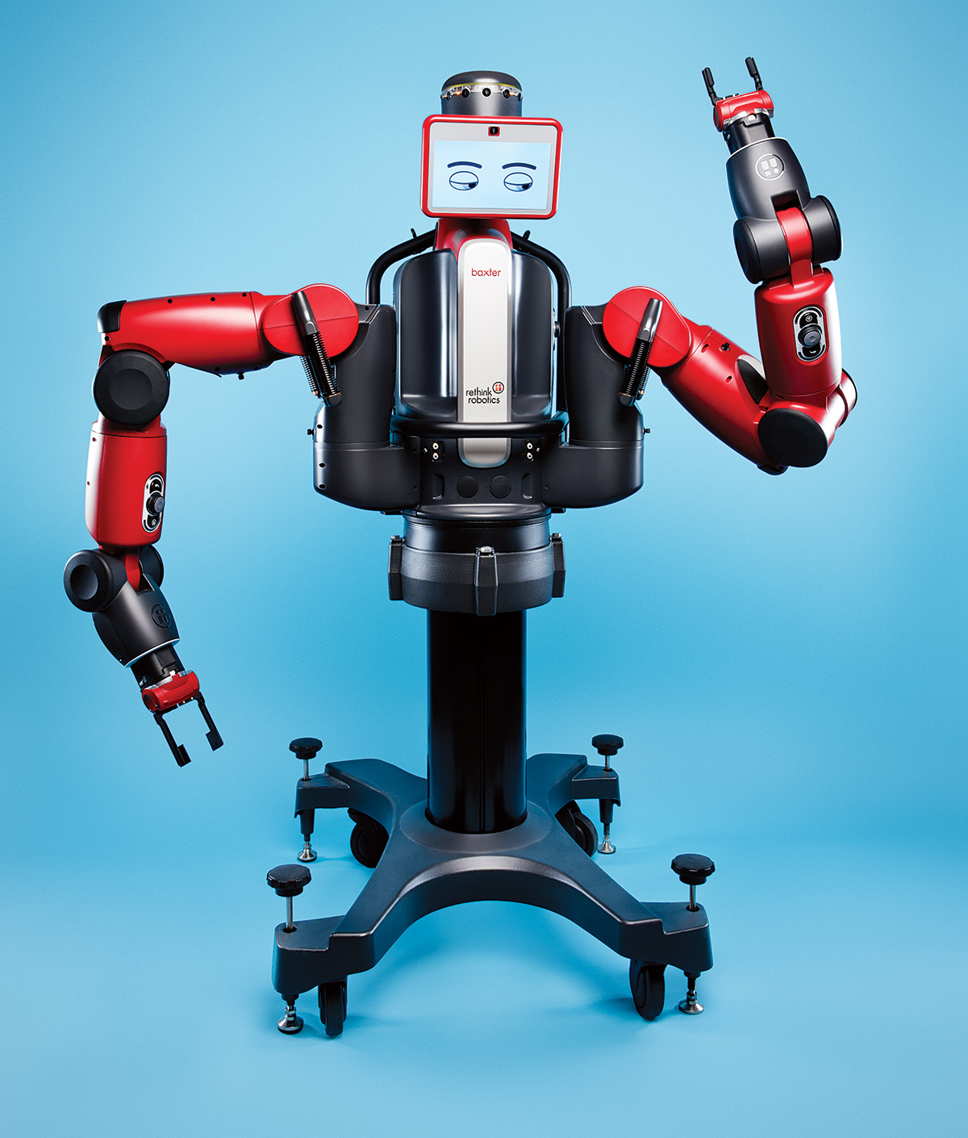
Background Study cont…
Behavior based robotics
20

Slide 21

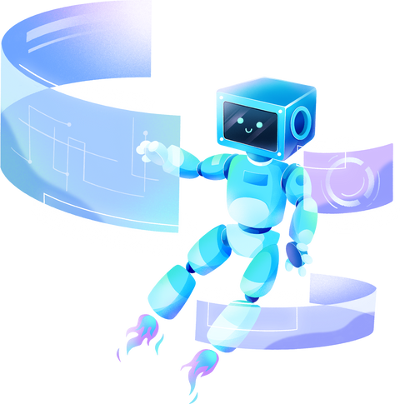
Background Study cont…
Advancement in modern era
21

Slide 22

Background Study cont…
Advancement in modern era
Steve Furber and Sophie Wilson’s contribution in computer architecture and microprocessor design
Use of PID (Proportional-Integral-Derivative) controllers
Affordability and simplicity
Advancements in sensor technology
22

Slide 23
Research Gap
23

Slide 24
Simplicity Over Complexity
Limited Adaptability
Rodney Brooks’ Limitations in Light Following Robot
Sensor Limitations
Scalability Issues
Limited Cognitive Abilities
24

Slide 25
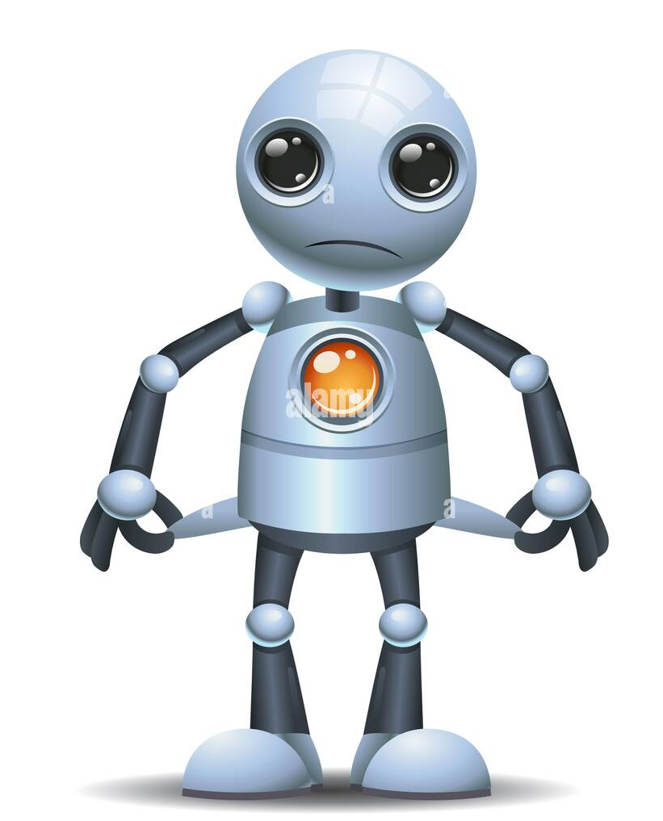
Areas to work in the future
Robustness in Dynamic Environments
Adaptability to Various Light Sources
Energy Efficiency
Real-World Applications and Human Interaction
Multi-Robot Coordination
25

Slide 26
Objective
To improve working conditions
A
To address labor shortages
A
B
?
B
To reduce the carbon footprint of industries and perform eco-friendly tasks
C
C
26

Slide 27
Methodology
27

Slide 28
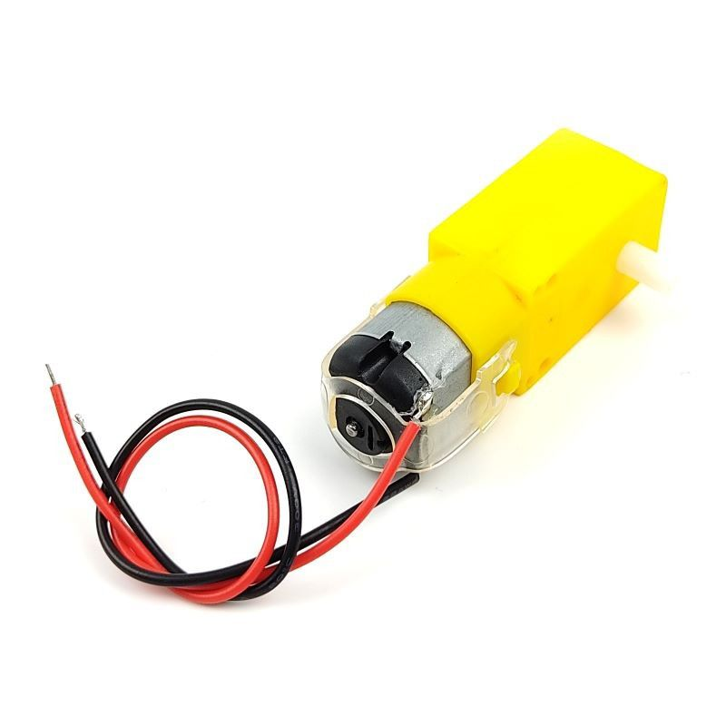
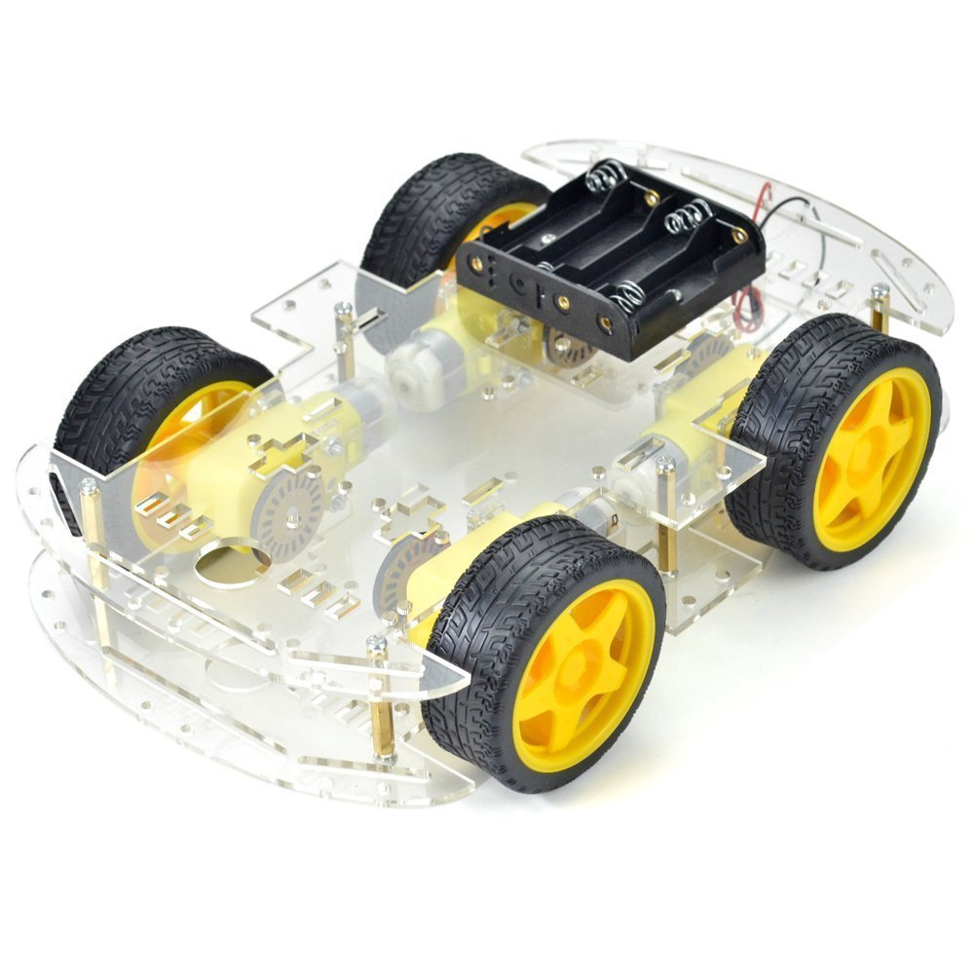
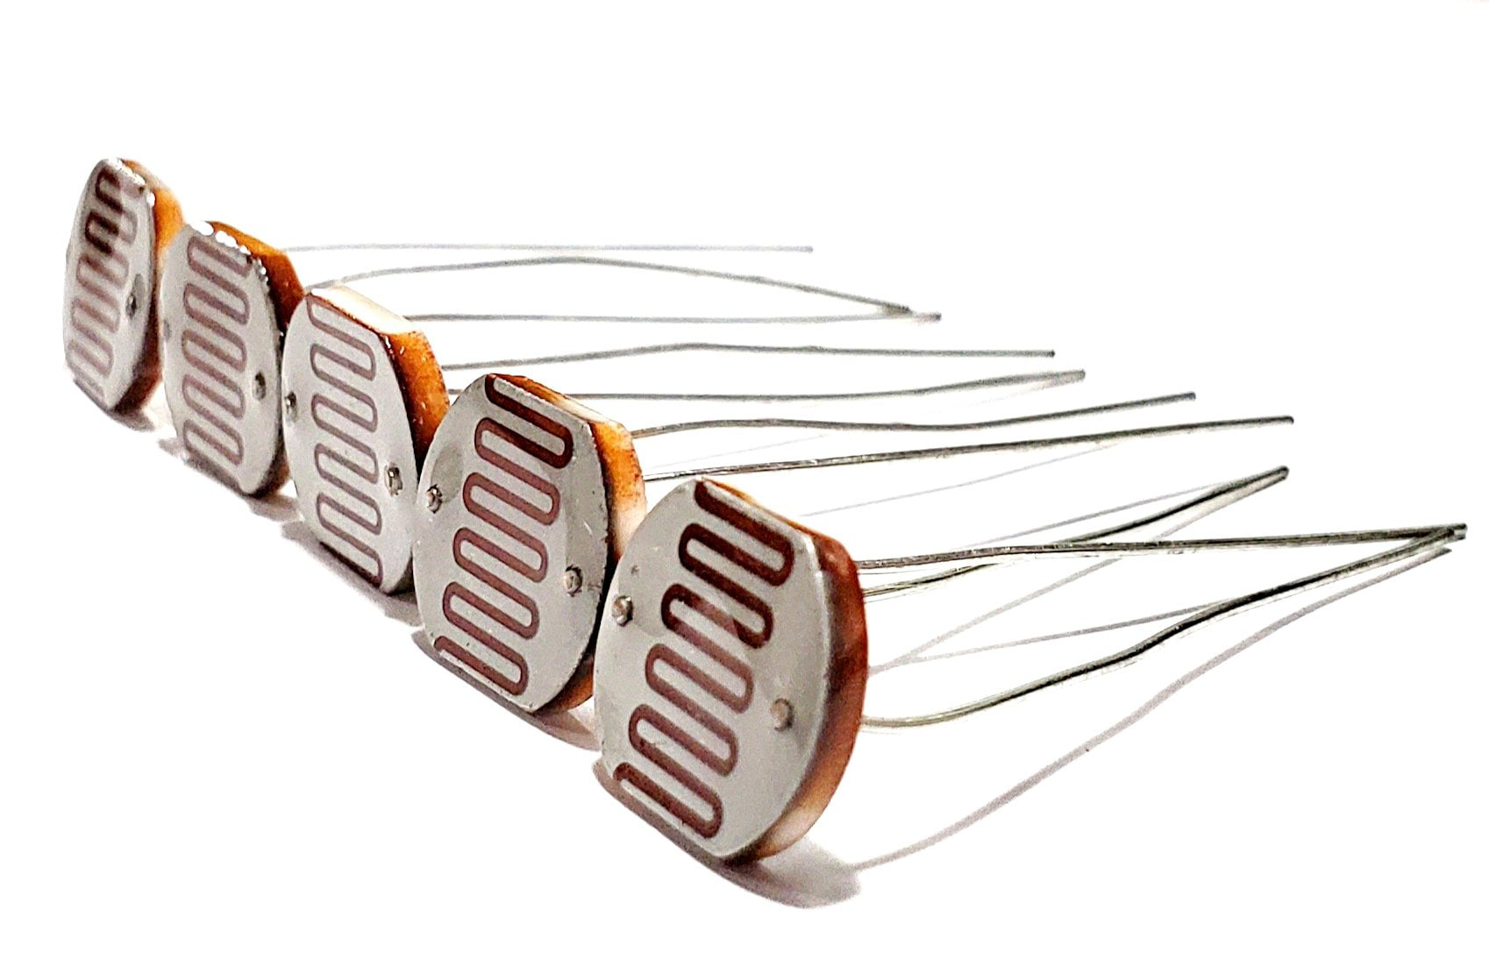
Components
TT Gear Motor
Car Chassis
LDR
28

Slide 29
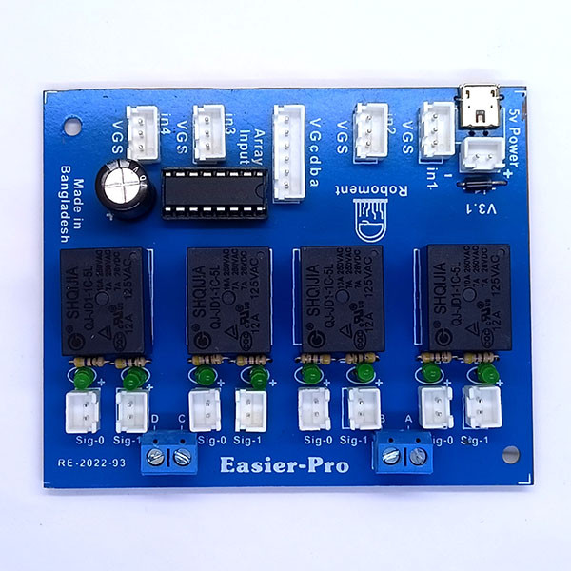
Easier Pro Development Board
.
29

Slide 30
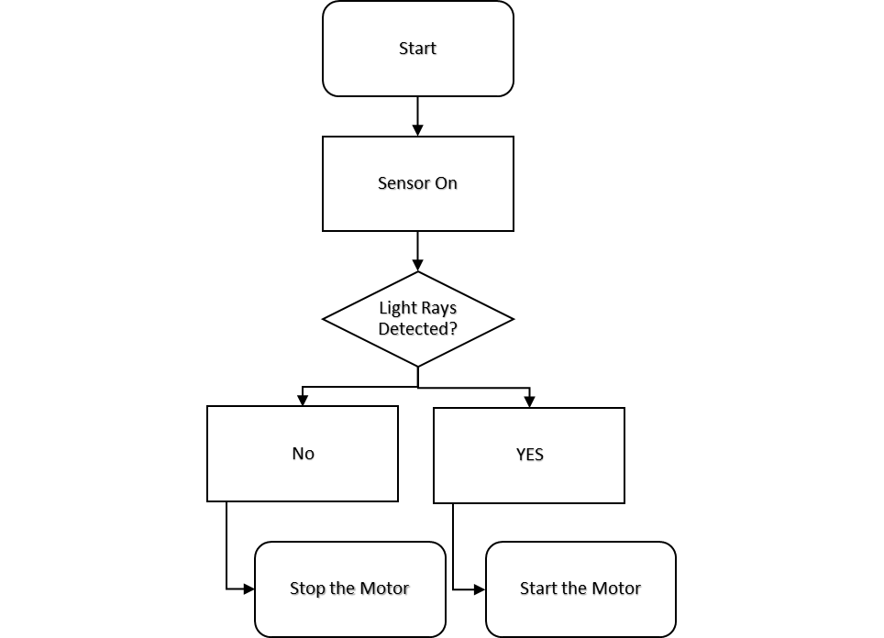
Flow Chart:
30

Slide 31
Conclusion
Why do we use LFR?
31

Slide 32
Future Scope
Autonomous Agriculture
2. Search and Rescue Operations
3. Smart Home Assistance
32

Slide 33
Thanks!
33

Slide 34
References
Accidents On Construction Cites In Bangladesh: A Review. Available at: https://www.semanticscholar.org/paper/ACCIDENTS-ON-CONSTRUCTION-SITES-IN-BANGLADESH%3A-A-Ahmed-Sobuz/65ed1cd48c7d622e421dd57f42e8ab7e5dedff23/ (Accessed: 24 April 2024).
(No date). Available at: https://www.mom.gov.sg/-/media/mom/documents/safety-health/reports-stats/wsh-national-statistics/wsh-national-stats-2023.pdf (Accessed: 25 April 2024).
Fenk, C. (2024) Tackling Labor Shortage with Robotics: 10 key findings for the Next-Gen, LinkedIn. Available at: https://www.linkedin.com/pulse/tackling-labor-shortage-robotics-10-key-findings-next-gen-fenk-mxgdf/ (Accessed: 24 April 2024)
Fenk, C. (2024) Tackling Labor Shortage with Robotics: 10 key findings for the Next-Gen, LinkedIn. Available at: https://www.linkedin.com/pulse/tackling-labor-shortage-robotics-10-key-findings-next-gen-fenk-mxgdf/ (Accessed: 24 April 2024)
Build a Speedy Light-Tracking Robot (BlueBot Project #2): Science Project (no date) Science Buddies. Available at: https://www.sciencebuddies.org/science-fair-projects/project-ideas/Robotics_p022/robotics/light-following-robot (Accessed: 24 April 2024).
W. G. Walter, The Living Brain, W. W. Norton Company, Inc., 1953.
R. Brooks, "Rodney Brooks - Roboticist," MIT Computer Science and Artificial Intelligence Laboratory. [Online]. Available: https://people.csail.mit.edu/brooks/. (Accessed: April 24, 2024)
R. A. Brooks, "Aspects of mobile robot visual map making" in Robotics Research, MA, Cambridge, vol. 2, pp. 369-375, 1984)
S. Wilson and S. Furber, "ARM creators Sophie Wilson and Steve Furber," The Register, May 2, 2012. [Online]. Available: https://www.theregister.com/2012/05/02/unsung_heroes_of_tech_arm_creators_sophie_wilson_and_steve_furber/ (Accessed: April 24, 2024)
(No date) Bing. Microsoft. Available at: https://www.bing.com/images/search?view=detailV2&ccid=TywOTwZJ&id=78B64DB84E13EFC593B719B6DE370CC4F93BA516&thid=OIP.TywOTwZJ6V6hfNyHxHL1rQAAAA&mediaurl=https%3A%2F%2Fth.bing.com%2Fth%2Fid%2FR.4f2c0e4f0649e95ea17cdc87c472f5ad%3Frik%3DFqU7%252bcQMN962GQ%26riu%3Dhttp%253a %252f%252fwww.technologystudent.com%252fimages5%252fldrmtr1.gif%26ehk%3DLSeH1IikZQU%252bAAsAlL%252fRm0SzWLPMGRe6eNJ0XshLBSg%253d%26risl%3D%26pid%3DImgRaw%26r%3D0&exph=230&expw=290&q=circuit%2Bdiagram%2Bof%2Blight%2Bdependent%2Bresistors&form=IRPRST&ck=8FD20539A52E05D96C30F1F999DE3E80&selectedindex=4&itb=0&qpvt=circuit%2Bdiagram%2Bof%2Blight%2Bdependent%2Bresistors&ajaxhist=0&ajaxserp=0&pivotparams=insightsToken%3Dccid_cF9c%252F%252Fzb%2Acp_1FE3CB94909D9A6B2F583EDB6F64C723%2Amid_8A03A2502D2D1C2416A5A6FBBE8B233E9DBB6A44%2Athid_OIP.cF9c%21_%21_zbGc2OyN%21_54u4vogAAAA&vt=0&sim=11&iss=VSI&simid=608018008069850688 (Accessed: 25 April 2024).

